Slide 1
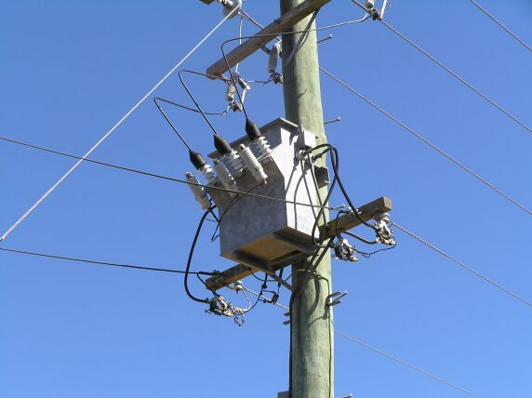
Lecture 3: Three-phase power circuits
Instructor:
Dr. Gleb V. Tcheslavski
Contact: gleb@ee.lamar.edu
Office Hours:
TBD; Room 2030
Class web site: MyLamar

Slide 2
Introduction
Almost all electric power generation and most of the power transmission in the world is in the form of three-phase AC circuits. A three-phase AC system consists of three-phase generators, transmission lines, and loads.
There are two major advantages of three-phase systems over a single-phase system:
More power per kilogram of metal form a three-phase machine;
Power delivered to a three-phase load is constant at all time, instead of pulsing as it does in a single-phase system.
The first three-phase electrical system was patented in 1882 by John Hopkinson - British physicist, electrical engineer, Fellow of the Royal Society.

Slide 3
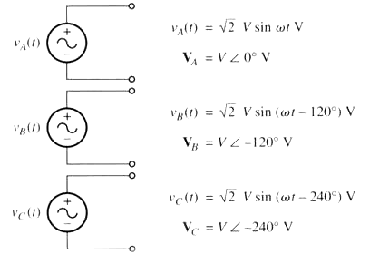
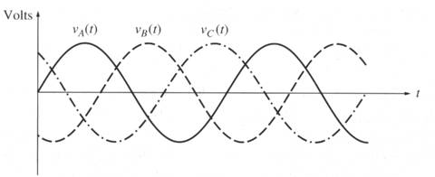
1. Generation of three-phase voltages and currents
A three-phase generator consists of three single-phase generators with voltages of equal amplitudes and phase differences of 120⁰.

Slide 4
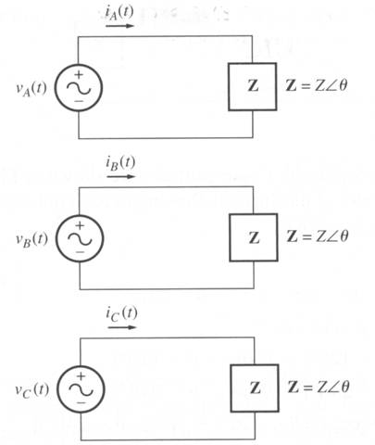
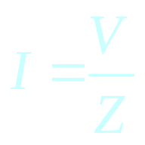
1. Generation of three-phase voltages and currents
Each of three-phase generators can be connected to one of three identical loads.
This way the system would consist of three single-phase circuits differing in phase angle by 120⁰.
The current flowing to each load can be found as
(3.4.1)

Slide 5
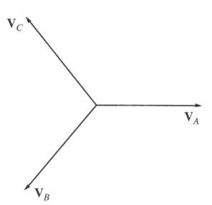
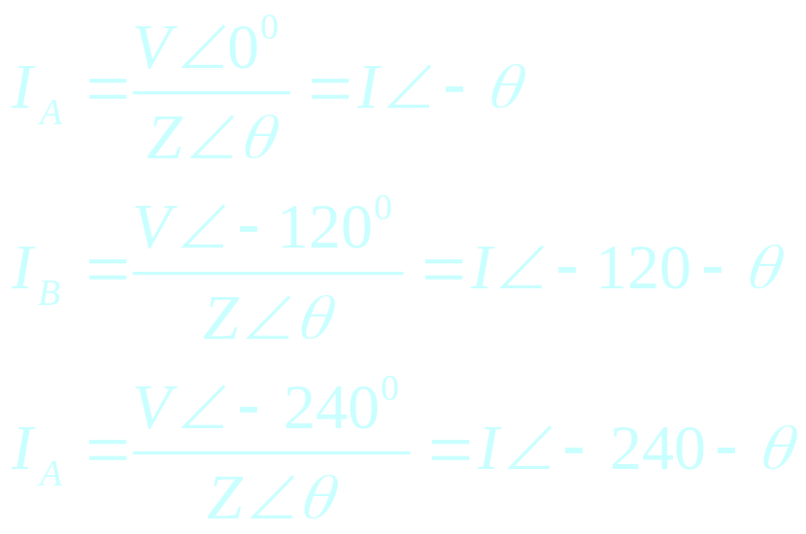
1. Generation of three-phase voltages and currents
Therefore, the currents flowing in each phase are
(3.5.1)
(3.5.2)
(3.5.3)

Slide 6
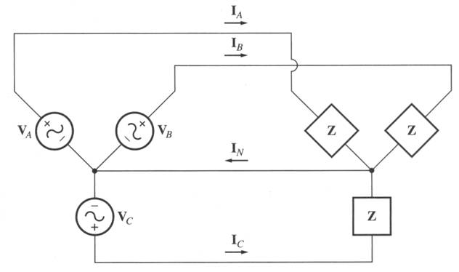
1. Generation of three-phase voltages and currents
We can connect the negative (ground) ends of the three single-phase generators and loads together, so they share the common return line (neutral).

Slide 7
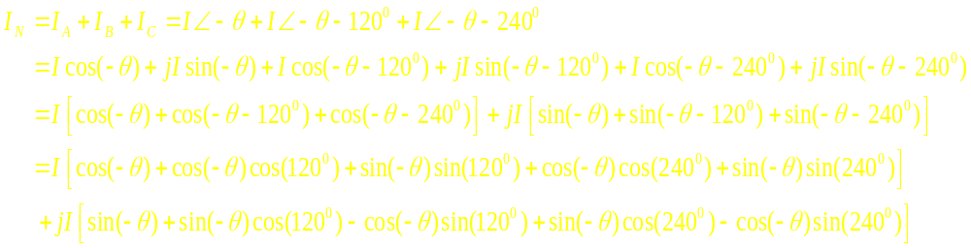
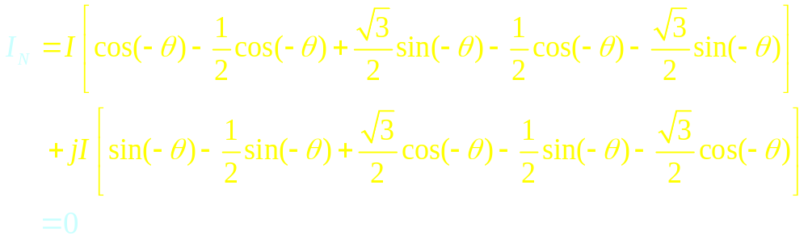
1. Generation of three-phase voltages and currents
The current flowing through a neutral can be found as
(3.7.1)
Which is:
(3.7.2)

Slide 8
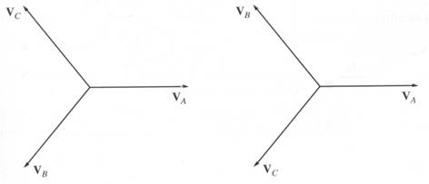
1. Generation of three-phase voltages and currents
As long as the three loads are equal, the return current in the neutral is zero!
Such three-phase power systems (equal magnitude, phase differences of 120⁰, identical loads) are called balanced.
In a balanced system, the neutral is unnecessary!
Phase Sequence is the order in which the voltages in the individual phases peak.
abc
acb

Slide 9
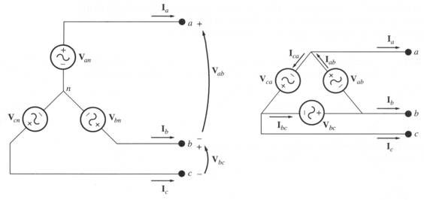
Voltages and currents
There are two types of connections in three-phase circuits: Y and Δ.
Each generator and each load can be either Y- or Δ-connected. Any number of Y- and Δ-connected elements may be mixed in a power system.
Phase quantities - voltages and currents in a given phase.
Line quantities – voltages between the lines and currents in the lines connected to the generators.

Slide 10
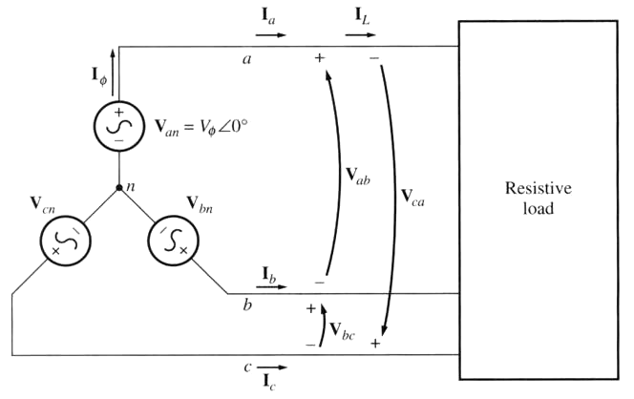
Voltages and currents
1. Y-connection
Assuming a resistive load…

Slide 11
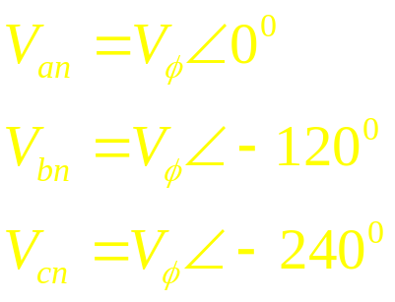
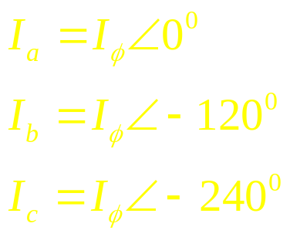
Voltages and currents
1. Y-connection (cont)
(3.11.1)
Since we assume a resistive load:
(3.11.2)

Slide 12
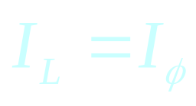
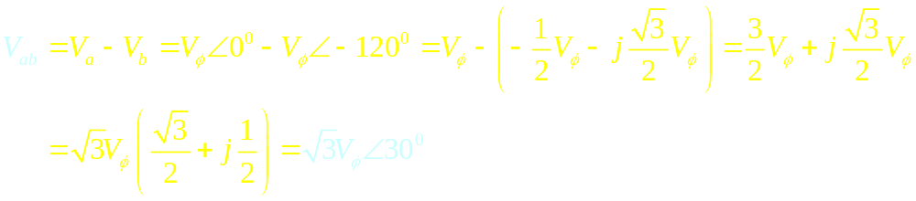
Voltages and currents
1. Y-connection (cont 2)
The current in any line is the same as the current in the corresponding phase.
(3.12.1)
Voltages are:
(3.12.2)

Slide 13
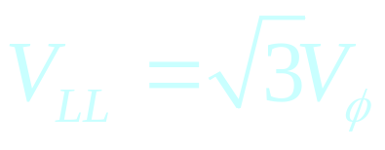
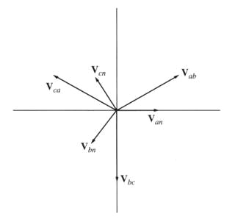
Voltages and currents
1. Y-connection (cont 3)
Magnitudes of the line-to-line voltages and the line-to-neutral voltages are related as:
(3.13.1)
In addition, the line voltages are shifted by 30⁰ with respect to the phase voltages.
In a connection with abc sequence, the voltage of a line leads the phase voltage.

Slide 14
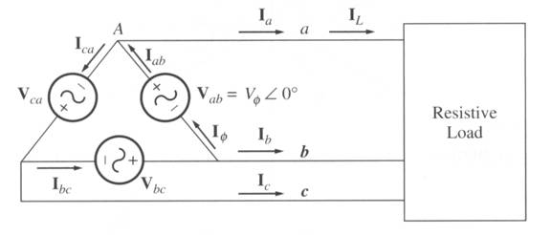
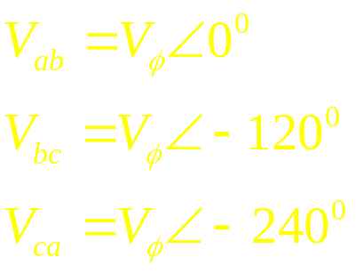
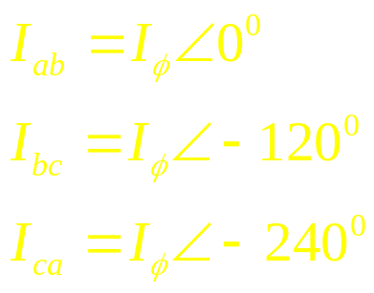
Voltages and currents
1. Δ-connection
assuming a resistive load:
(3.14.1)
(3.14.2)

Slide 15
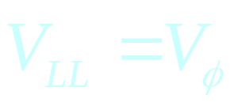
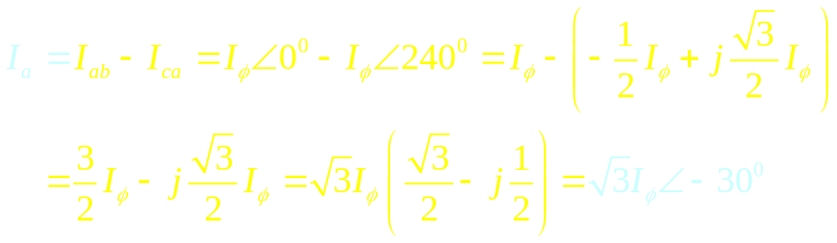
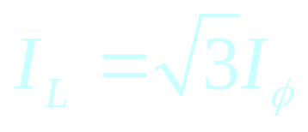
Voltages and currents
1. Δ-connection (cont)
(3.15.1)
The currents are:
(3.15.2)
The magnitudes:
(3.15.3)

Slide 16
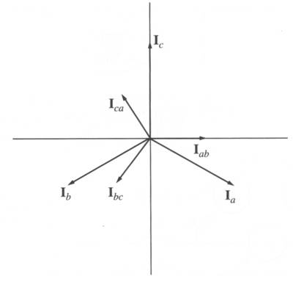
Voltages and currents
For the connections with the abc phase sequences, the current of a line lags the corresponding phase current by 30⁰ (see Figure below).
For the connections with the acb phase sequences, the line current leads the corresponding phase current by 30⁰.

Slide 17
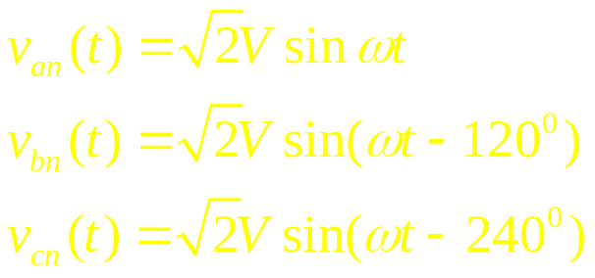
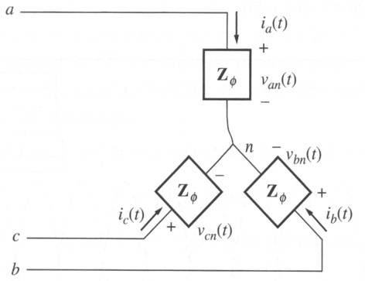
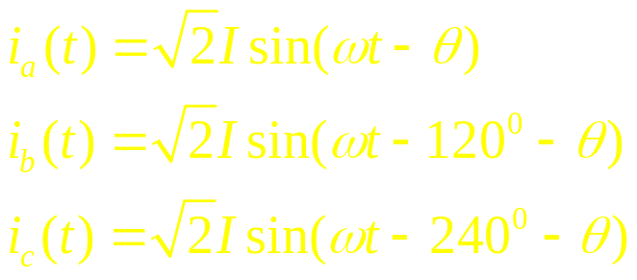
Power relationships
For a balanced Y-connected load with the impedance Z_{φ} = Z∠θ⁰:
and voltages:
(3.17.1)
The currents can be found:
(3.17.2)

Slide 18

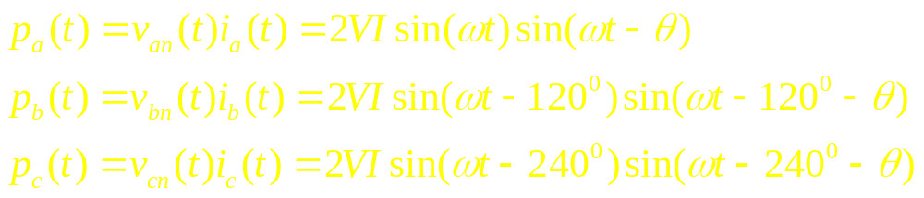
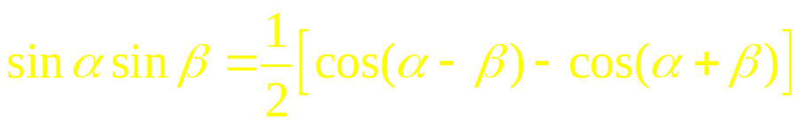
Power relationships
The instantaneous power is:
(3.18.1)
Therefore, the instantaneous power supplied to each phase is:
(3.18.2)
Since
(3.18.3)

Slide 19
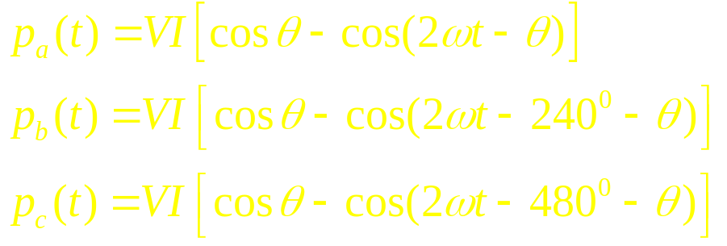
Power relationships
Therefore
(3.19.1)
The total power on the load
(3.19.2)
The pulsing components cancel each other because of 120⁰ phase shifts.

Slide 20
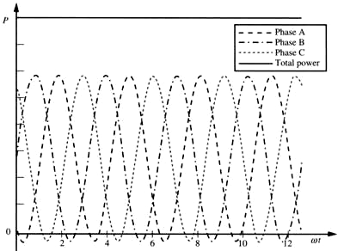
Power relationships
The instantaneous power in phases.
The total power supplied to the load is constant.

Slide 21
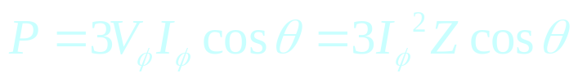
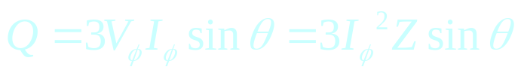
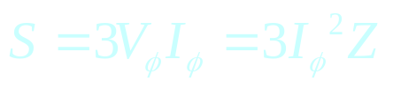
Power relationships
Phase quantities in each phase of a Y- or Δ-connection.
Real
(3.21.1)
Reactive
(3.21.1)
Apparent
(3.21.1)
Note: these equations are valid for balanced loads only.

Slide 22

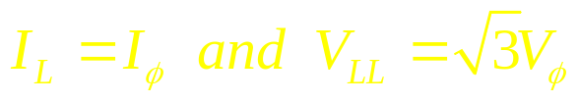
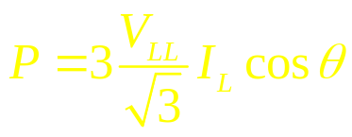
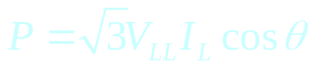
Power relationships
Line quantities: Y-connection.
Power consumed by a load:
(3.22.1)
Since for this load
(3.22.2)
Therefore:
(3.22.3)
Finally:
(3.22.4)
Note: these equations are valid for balanced loads only.

Slide 23
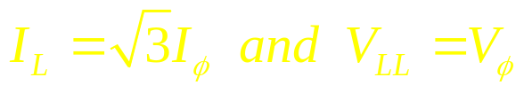
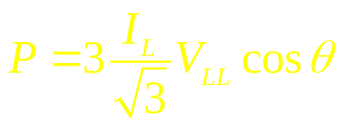
Power relationships
Line quantities: Δ-connection.
Power consumed by a load:
(3.23.1)
Since for this load
(3.23.2)
Therefore:
(3.23.3)
Finally:
(3.23.4)
Same as for a Y-connected load!
Note: these equations were derived for a balanced load.

Slide 24
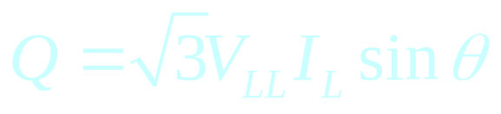
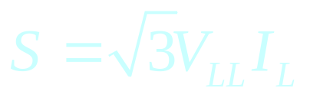
Power relationships
Line quantities: Y- and Δ-connection.
Reactive power
(3.24.1)
Apparent power
(3.24.2)
Note: θ is the angle between the phase voltage and the phase current – the impedance angle.

Slide 25
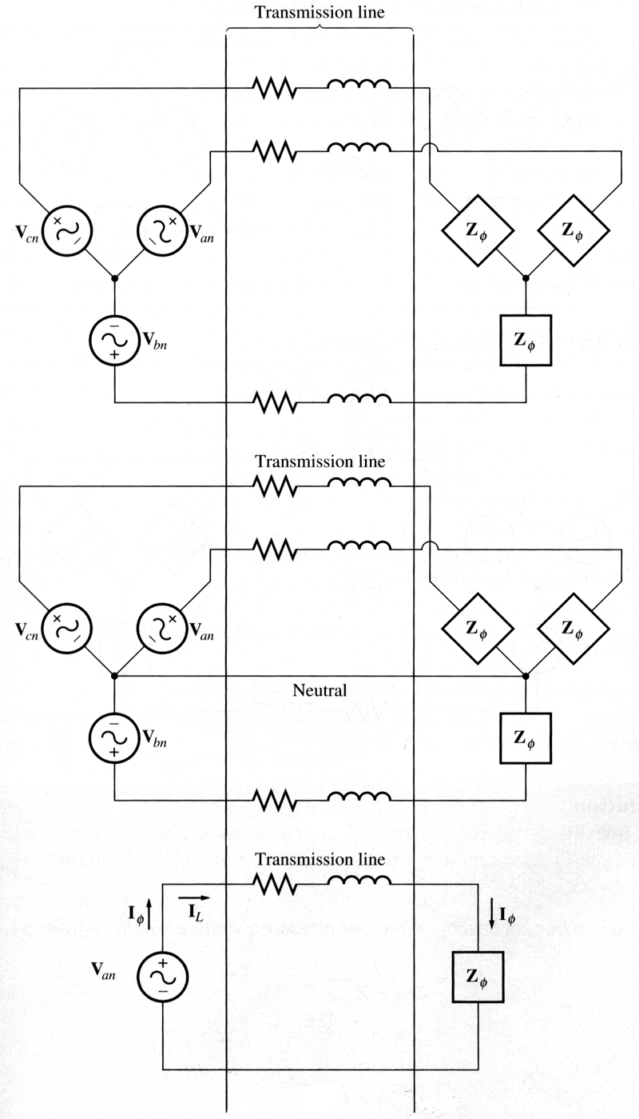
Analysis of balanced systems
We can determine voltages, currents, and powers at various points in a balanced circuit.
Consider a Y-connected generator and load via three-phase transmission line.
For a balanced Y-connected system, insertion of a neutral does not change the system.
All three phases are identical except of 120⁰ shift. Therefore, we can analyze a single phase (per-phase circuit).
Limitation: not valid for Δ-connections…

Slide 26
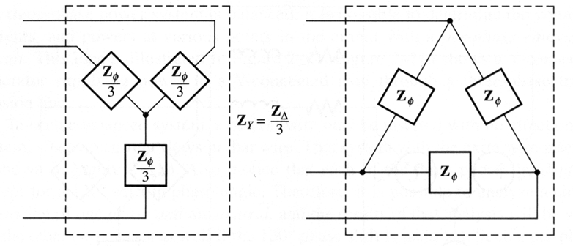
Analysis of balanced systems
A Δ-connected circuit can be analyzed via the transform of impedances by the Y-Δ transform. For a balanced load, it states that a Δ-connected load consisting of three equal impedances Z is equivalent to a Y-connected load with the impedances Z/3. This equivalence implies that the voltages, currents, and powers supplied to both loads would be the same.

Slide 27
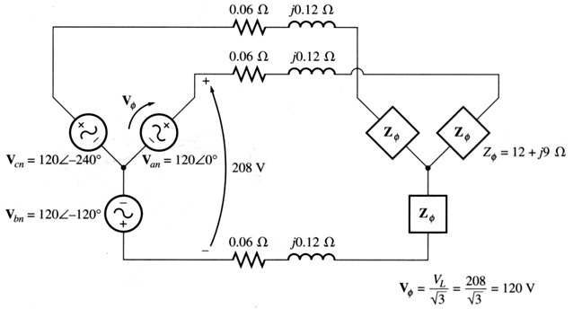
Analysis of balanced systems: Ex
Example 3-1:
for a 208-V three-phase ideally balanced system, find:
the magnitude of the line current I_{L};
The magnitude of the load’s line and phase voltages V_{LL} and V_{φL};
The real, reactive, and the apparent powers consumed by the load;
The power factor of the load.

Slide 28
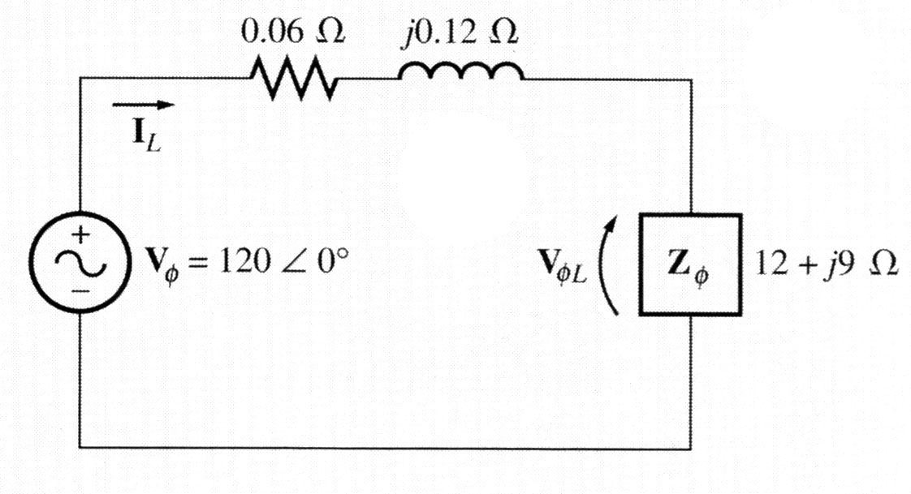
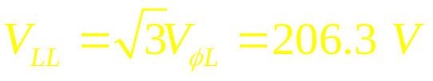
Analysis of balanced systems: Ex
Both, the generator and the load are Y-connected, therefore, it’s easy to construct a per-phase equivalent circuit…
Btw: is the load inductive or capacitive??
a) The line current:
b) The phase voltage on the load:
The magnitude of the line voltage on the load:

Slide 29
Analysis of balanced systems: Ex
c) The real power consumed by the load:
The reactive power consumed by the load:
The apparent power consumed by the load:
d) The load power factor:

Slide 30
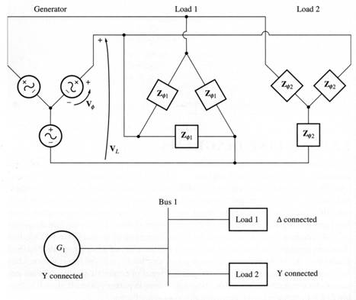
One-line diagrams
Since, in a balanced system, three phases are similar except of the 120⁰ phase shift, power systems are frequently represented by a single line showing all three phases of the real system.
This is a one-line diagram.
Such diagrams usually include all the major components of a power system: generators, transformers, transmission lines, loads.

Slide 31
Using the power triangle
If we can neglect the impedance of the transmission line, an important simplification in the power calculation is possible…
If the generator voltage in the system is known, then we can find the current and power factor at any point in the system as follows:
The line voltages at the generator and the loads will be identical since the line is lossless.
Real and reactive powers on each load.
The total real and reactive powers supplied to all loads from the point examined.
The system power factor at that point using the power triangle relationship.
Line and phase currents at that point.
We can treat the line voltage as constant and use the power triangle method to quickly calculate the effect of adding a load on the overall system and power factor.

